Slide 1
case study visual data
File created on: 1/10/2024 1:44:55 PM

Slide 2
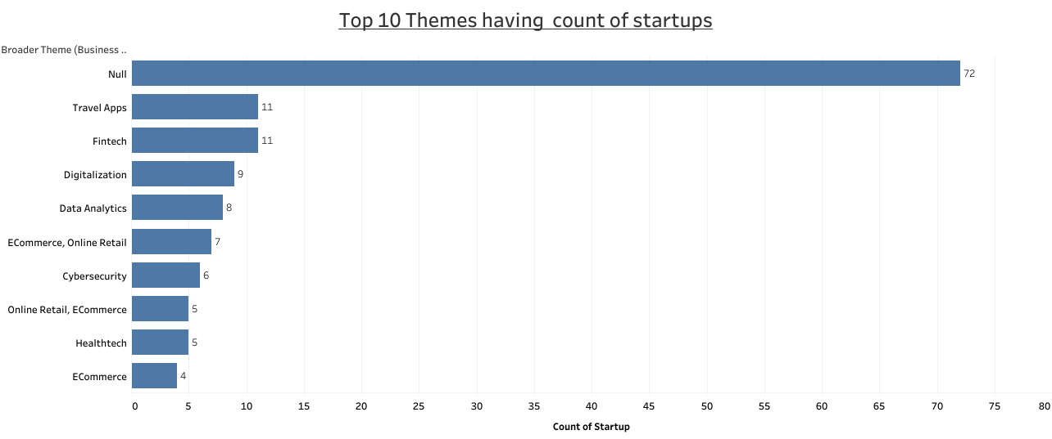

Identify the most prevalent themes across startups. This can help in understanding the dominant areas of innovation and investment.

Slide 3
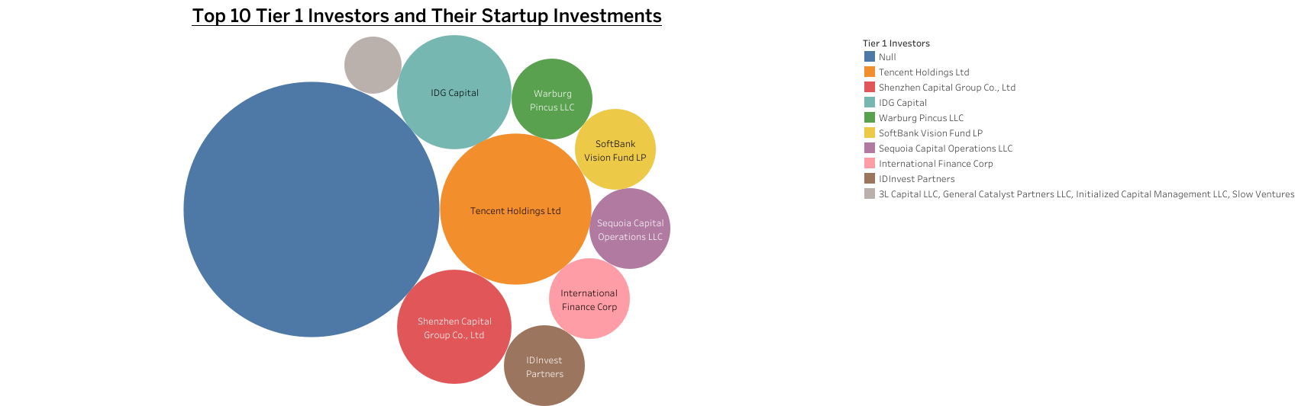
Recognize which investors have the highest involvement in startup funding. This information can be valuable for startups seeking funding and for investors assessing their competition.

Slide 4
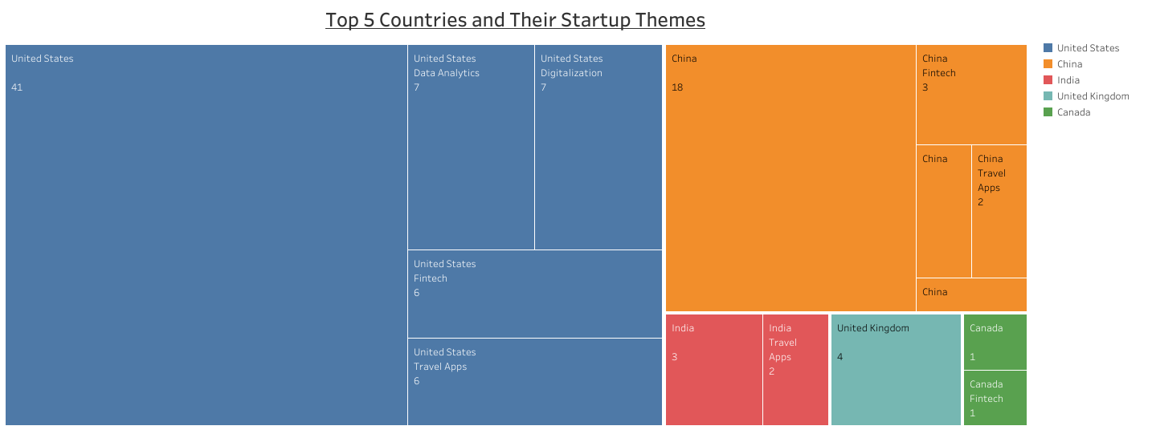
Understand the distribution of startup themes across different countries. This can highlight global trends and regional strengths in specific industries.

Slide 5
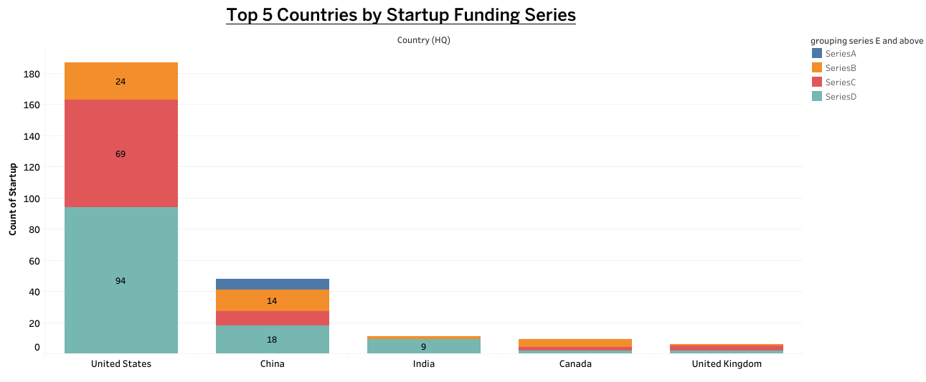
Analyze how different funding series are distributed across the top 5 countries. This can provide insights into the maturity and growth stages of startups in various regions.

Slide 6
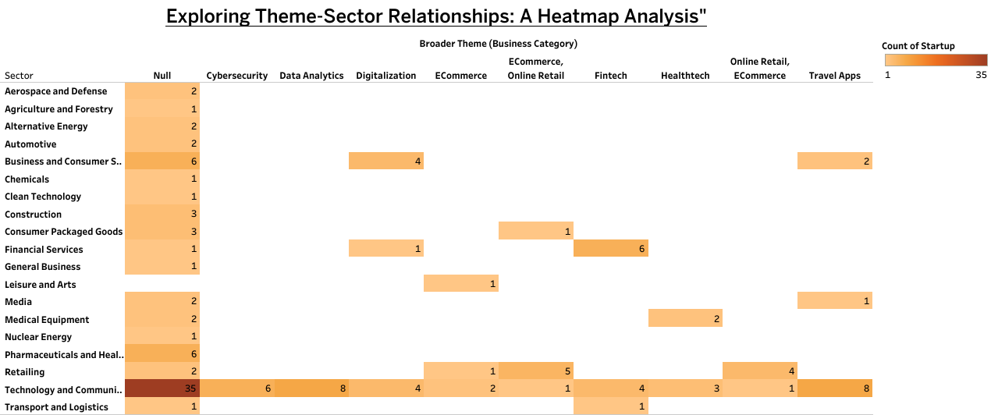

Visualize the correlation between startup themes and sectors. This can reveal patterns in the types of startups emerging in different sectors.

Slide 7
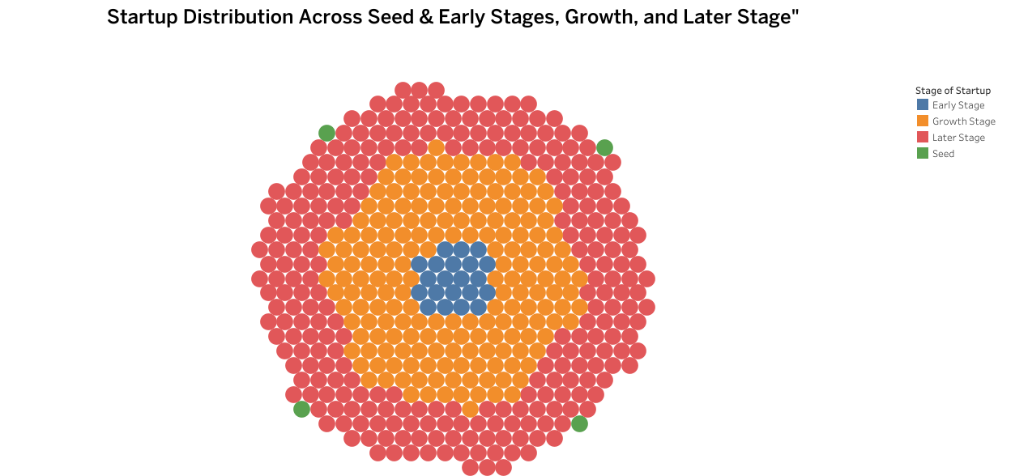
Compare the distribution of startups across different stages. This can provide an overview of the startup ecosystem's maturity in terms of seed, early, growth, and later stages.

Slide 8
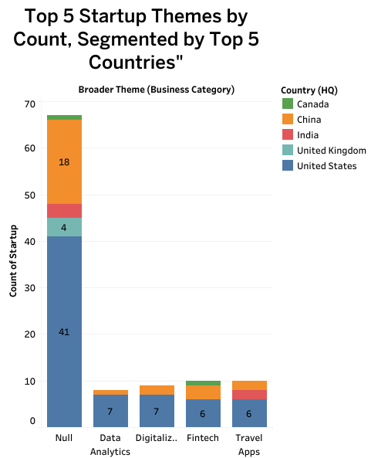
Explore the intersection of popular themes and top countries. Identify which themes dominate in specific regions, offering insights into regional strengths and preferences.

Slide 9
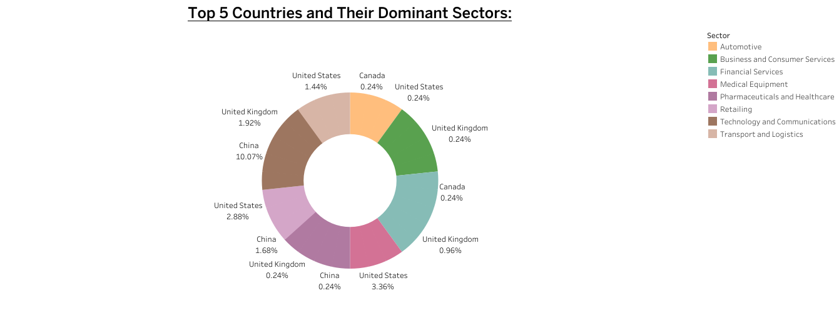
Show the percentage distribution of sectors within each country. This can help in understanding the specialization of countries in particular industries.

